Slide 1
Advanced Software Engineering Concepts
UNIT-III
25MCA203: SOFTWARE ENGINEERING AND TESTING

Slide 2
Software Engineering Paradigms
Software engineering paradigms are structured approaches used to design, develop, and organize software systems. They help manage complexity, provide clear structure, and guide the development process from requirements to maintenance.
So paradigms help developers to:
Manage complexity
Structure software properly
Improve teamwork
Reduce errors
Maintain software easily

Slide 3
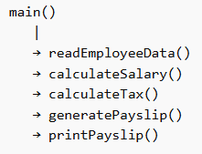
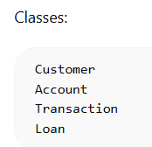
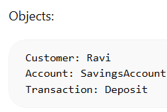
Software Engineering Paradigms (Conceptual Approaches)
1. Procedural Paradigm
• Software is organized as a sequence of procedures or functions
• Emphasis on step-by-step execution
• Example: Payroll processing system using functions
2. Object-Oriented Paradigm
• Software is modeled using objects and classes
• Supports encapsulation, inheritance, and polymorphism
• Example: Banking system with Account and Customer objects
3. Functional Paradigm
• Focuses on mathematical functions and immutability.
• Avoids shared data and side effects
• Example: Data transformation using pure functions

Slide 4
Software Engineering Paradigms (Conceptual Approaches)
4. Data-Centered (Data-Driven) Paradigm
• Software behavior revolves around data and databases
• Applications are built around data storage and retrieval
• Example: Inventory management system driven by database operations
5. Agile Paradigm
• Emphasizes iterative development and customer feedback
• Flexible to changing requirements
• Example: Mobile app developed in short sprints
6. DevOps Paradigm
• Integrates development and operations
• Focuses on automation and continuous delivery
• Example: Automated deployment of a web application

Slide 5
Software Development Models (Process Flows/SDLCs)
Every software engineering organization should describe a unique set of framework activities for the software process it adopts.
Waterfall Life Cycle Model.
Iterative Waterfall Life Cycle Model.
Prototyping Model.
Incremental Model.
Sprial Model.
RAD Model.
Sprial Model.

Slide 6
Waterfall Life Cycle Model.
It is called classic life cycle or Linear model.
Requirements are well defined and stable.
It suggests a systematic, sequential approach to software development.
It begins with customer specification of requirements and progresses.
Planning.
Modeling.
Construction and
Deployment.

Slide 7
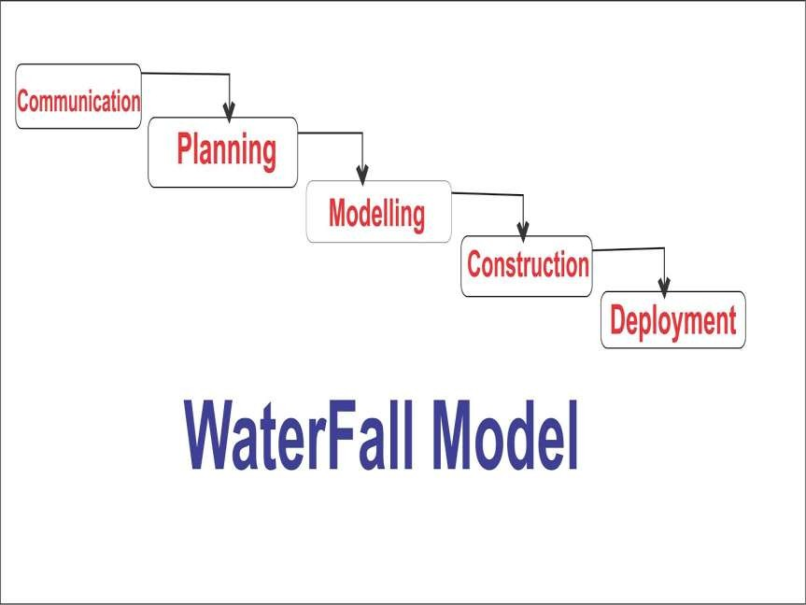

Slide 8
Advantages:
Easy to understand.
Each phase has well defined input and output.
Helps project manger in proper planning of project.
Provides a templates into which methods of analysis, design, code and support can be placed.
Disadvantages:
One way street.
It lack overlapping and interactions among phases.
Model doesn’t support delivery of system in pieces.

Slide 9
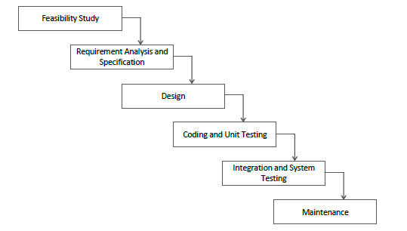
Phases of the Classical Waterfall Model:

Slide 10
Feasibility Study:
It involves analysis of the problem and collection of all relevant information relating to the product.
The collected data are analysed.
Requriments of the Customer.
Formulations of the different strategies for solving the
problem.
Evaluation of different solution strategies.
Requriments Analysis and Specification:
It is understand the exact requriments of the customer
and to document them properly.
Requirements gathering and analysis.
Requirements specification.

Slide 11
Design:
The deign phase is to transform the requirements specified in the document into a structure that is suitable for implementation in some programming languaage.
Traditional Design Approach.
Object-Oriented Design Approach.
Coding and Unit Testing:
The purpose of the coding and unit testing phase of software development is to translate the software design into source code.
Integration and System Testing:
‘Integration of different modules is coded and unit tested.
Integration testing
𝛼 − 𝑇𝑒𝑠𝑡𝑖𝑛𝑔
𝛽 − 𝑇𝑒𝑠𝑡𝑖𝑛𝑔
Acceptance Testing.

Slide 12
Maintenance:
Maintenance of a typical software products requires much more than the effort necessary to develope the product itself.
Iterative Waterfall life cycle model:
The main changes is done by providing feedback paths from every phase to its preceding phase.

Slide 13
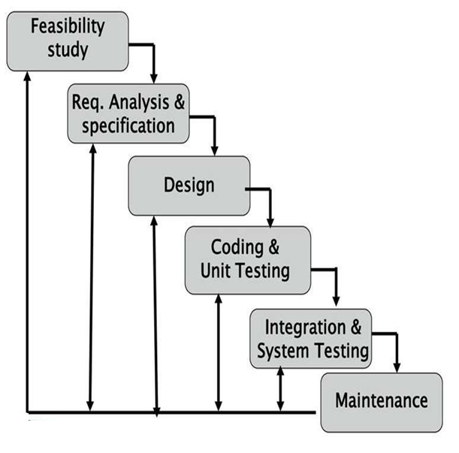

Slide 14
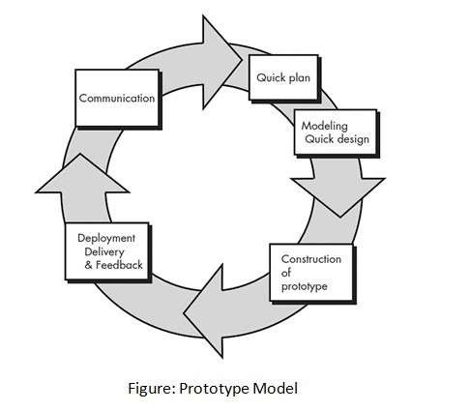
Prototype Model:
A software prototyping model is a development model in which a prototype is built, tested, and reworked until an acceptable prototype is achieved.

Slide 15
Advantages:
Clarity.
Risk Identification.
Good Environment.
Take less time to complete.
Disadvantages:
High cost.
Slow process.
Too many changes.

Slide 16
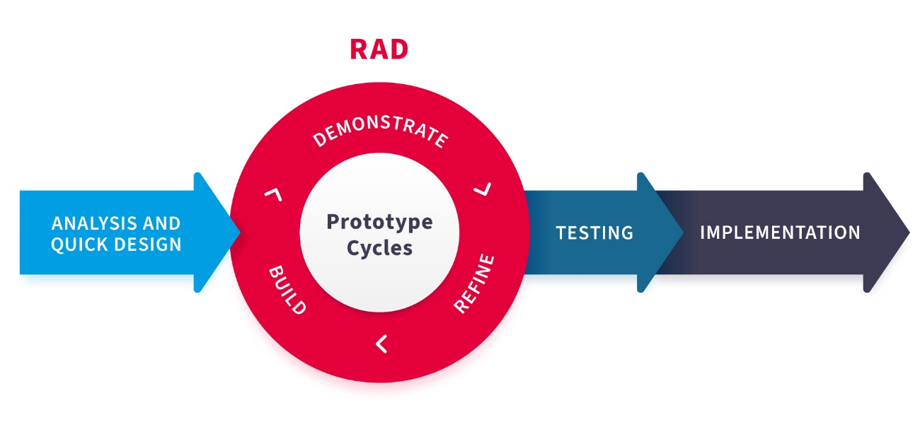
RAD Model:
Rapid Application Development(RAD) is an incremental software model that a short development cycle.
The RAD model is a “high-speed” of the waterfall model.
The RAD process enables a development team to create a fully functional system within a very short time period.
In traditional models (like Waterfall), you spend months planning before you ever see the software. In RAD, you build a "rough draft" almost immediately, show it to the user, get their feedback, and fix it right then and there.

Slide 17
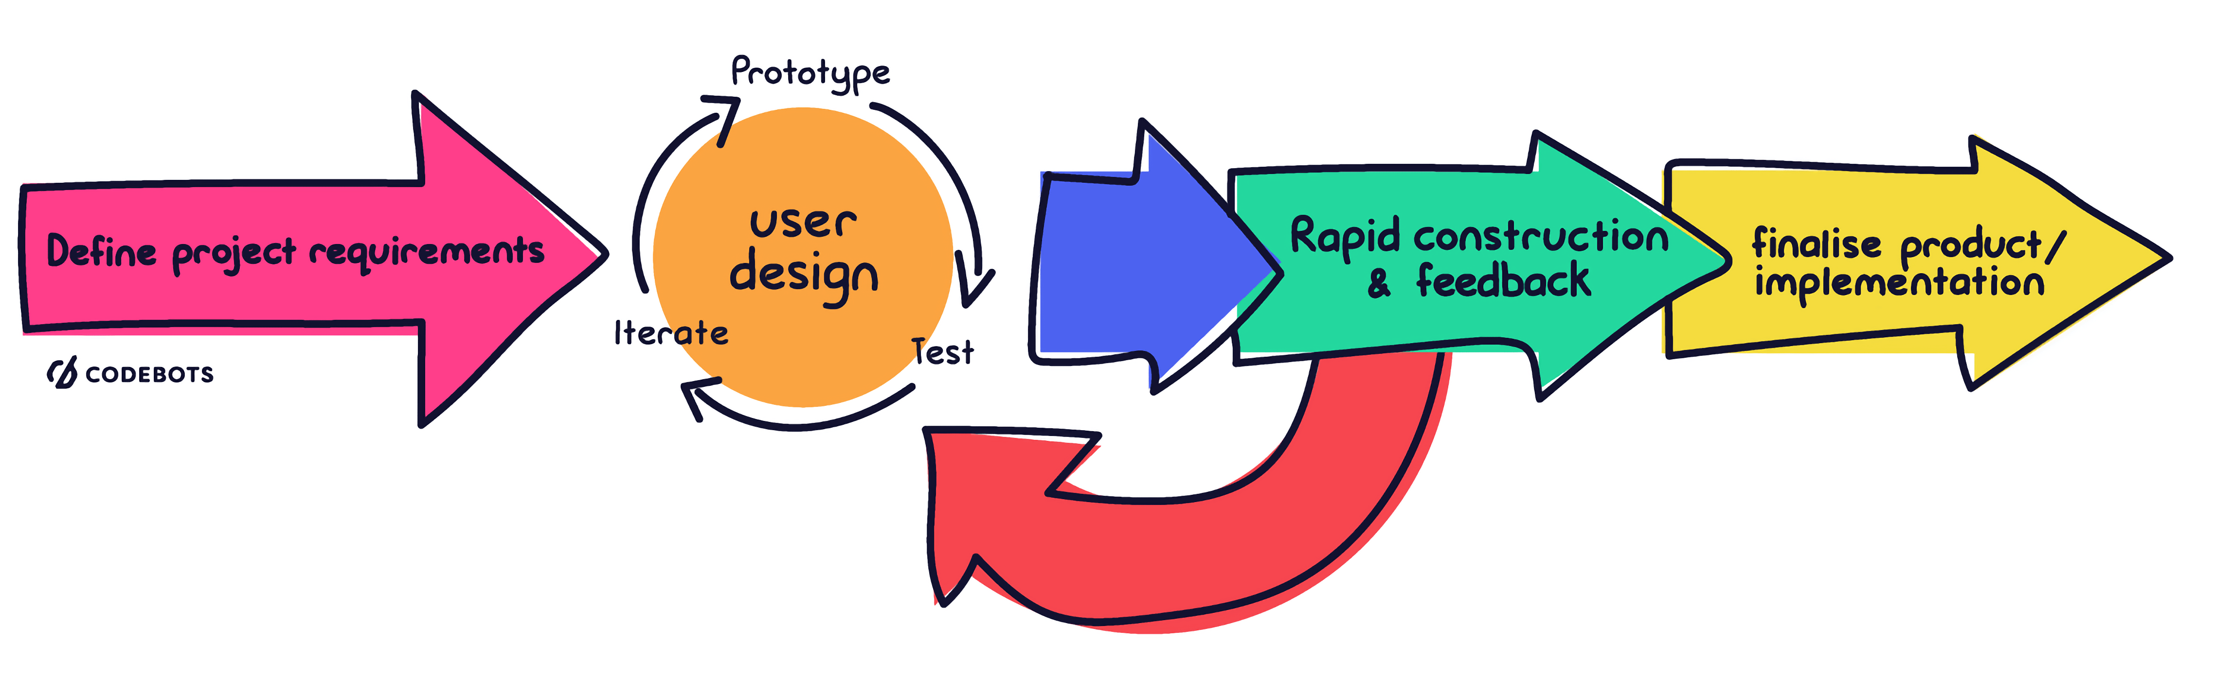
The 4 Key Phases of RAD
Requirements Planning: Instead of a 200-page document, developers and users meet to agree on the broad goals and project scope. We don't worry about every tiny detail yet.
Real-Life Example: "We need an app for our delivery drivers to track packages.“
User Design (Prototyping Loop): This is the "heart" of RAD. Developers build multiple prototypes (rough versions) of the app. Users test them and say, "I don't like this button" or "This screen is confusing."
Real-Life Example: The driver says, "The text is too small to read while I'm wearing gloves." The developer changes it immediately.
Construction (Rapid Development): Once the prototype is approved, the team uses automated tools (like Low-Code platforms or code generators) to turn those rough drafts into a polished, final product.
Cutover (Deployment): The final system is integrated, tested, and handed over to the user. Because the user has been involved since Day 1, there are rarely any "surprises" at this stage.

Slide 18
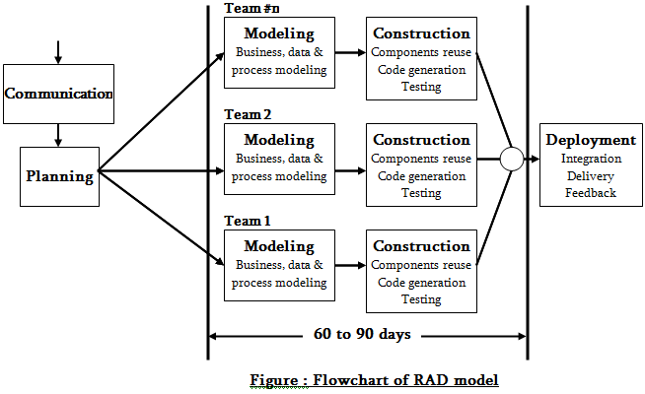
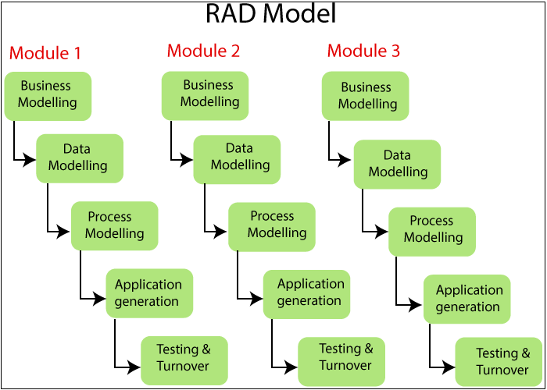

Slide 19
Contents of RAD Pakages:
Graphical user development environment - Using visual tools to "drag and drop" interface elements instead of writing every line of UI code.
Reusable Components- use pre-written code modules for common tasks.
Code generator- Software that automatically writes the basic "back-end" code for you based on your design models.
Advantages:
Fast products.
Efficient Documentation.
Interaction with user.
Disadvantages:
User may not like fast activities.
Not suitable for technical risks.

Slide 20
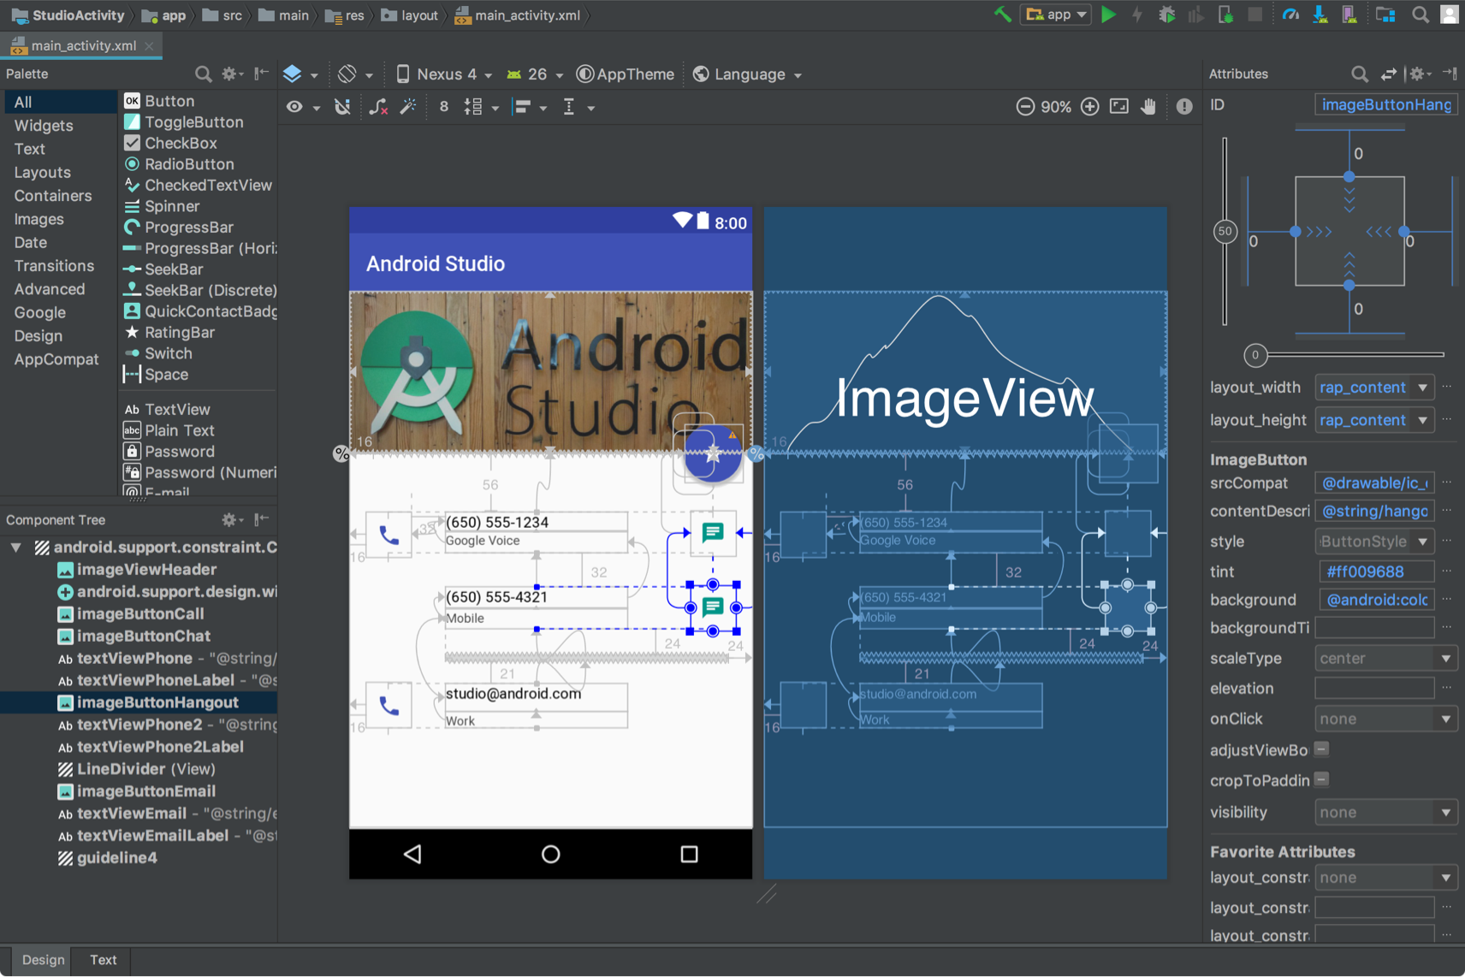

Slide 21
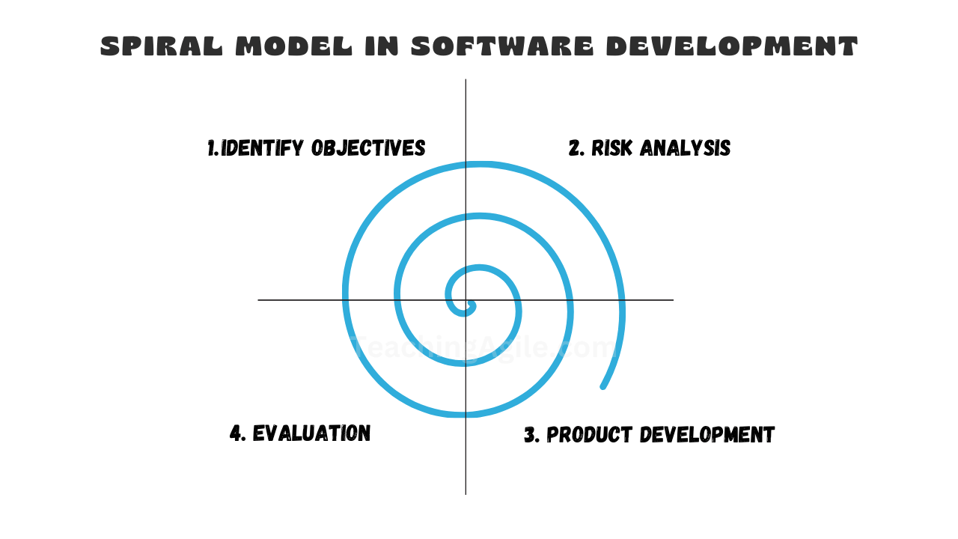
Sprial Model :
This Spiral model is a combination of iterative development process model and sequential linear development model i.e. the waterfall model with a very high emphasis on risk analysis.
The spiral model has four phases: Planning, Design, Construct and Evaluation.
Every time you go around the circle, you build a more complete version of the software, but only after you have carefully analyzed what could go wrong.

Slide 22
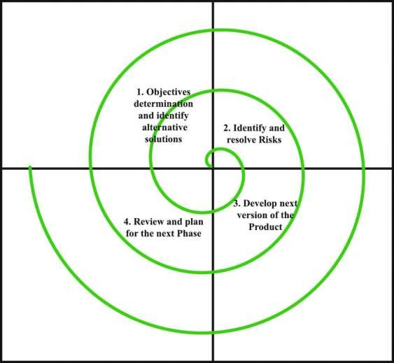
Quadrants in sprial model :
Objective Setting (Top-Left): You define the goals for this specific loop. What features are we adding? What are the constraints (budget, time)?
Risk Assessment and Reduction (Top-Right): This is the most unique part of the model. You identify everything that could fail (technical bugs, high costs, user rejection) and create prototypes to "prove" the concept before moving forward.
Development and Validation (Bottom-Right): You actually write the code. Depending on where you are in the project, you might use different methods here—for example, using Object-Oriented Design (OOD) to structure the code or Implementation to realize the program.
Planning (Bottom-Left): You review the progress with the client and plan the next loop of the spiral.

Slide 23
Why Use the Spiral Model?
The Spiral model is essentially a series of Waterfalls or RAD cycles joined together by heavy risk analysis.
Real-Life Example: Imagine NASA building software for a Mars Rover.
Loop 1: Can the Rover move its wheels? (Build a prototype, test it).
Loop 2: Can it survive a sandstorm? (Simulate risks, build more code).
Loop 3: Can it send photos to Earth?
Each loop adds a layer of complexity only after the previous layer is proven safe.

Slide 24
Advantages :
Risk Identification at early stage.
Suitable for high risk projects.
Flexibility for adding functionality- You can add new requirements even late in the life cycle.
Disadvantages:
Expensive: Analyzing risks every single loop requires highly skilled experts.
Complex Management: The project doesn't have a clear "end date" because the spiral can theoretically go on forever.
Not suitable for smaller projects: For a simple website, the "Risk Assessment" would take longer than the actual coding!
Difficult to meeting budget.

Slide 25
Win-Win Spiral Model
While the standard Spiral Model focuses on Risk, the Win-Win Spiral Model adds a focus on People and Negotiation.
It acknowledges a simple truth: in software engineering, if the customer is unhappy because it costs too much, or the developer is unhappy because the deadline is impossible, the project will fail—even if the code is perfect.
The customer wins by getting the system satisfying most of their requirements and developers wins by working on achievable budgets and deadlines.
The Win-Win Spiral Model teaches us that negotiation is a technical skill. If you can't get your stakeholders to agree on a "Win-Win" plan, no amount of clever coding will save the project.

Slide 26
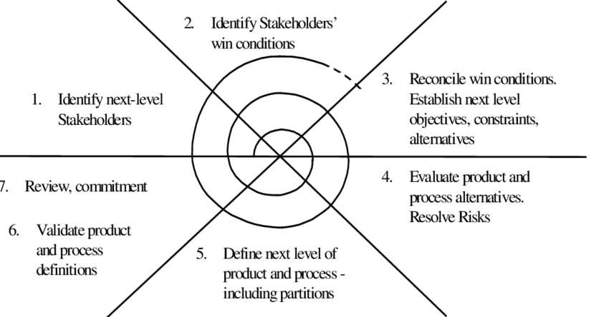
Phase 1: Identifying Stakeholders
The process starts in the top-left quadrant of the spiral.
Action: Before any technical work begins, you must Identify next-level Stakeholders.
This means looking ahead to the next phase of the project and seeing whose "buy-in" you need—be it the legal team for a new feature or the actual end-users who will operate the weather station.
Phase 2: Identifying Win Conditions
Moving to the top-right quadrant, the focus shifts to individual goals.
Action: You must Identify Stakeholders' win conditions.
The Goal: You are explicitly asking what each group needs to consider the project a success.
Example: For our Weather Station, a "Win" for the maintenance team might be "remote restart capability," while a "Win" for the customer is "low manufacturing cost"

Slide 27
Building a Library App
The Conflict: The Librarians want a feature that tracks every book a student has ever read. The Legal Team says that's a privacy violation and could lead to a lawsuit.
The Win-Win Negotiation: * The Librarians agree to only track current books.
The Legal Team approves the privacy policy.
Result: The Librarians get their tracking, and the Legal Team gets their safety. Both "win," and the project moves to the next loop of the spiral.

Slide 28
Phase 3: Negotiating Reconciliations
This is the most critical addition, occurring just before the standard "Risk" assessment.
Action: You Reconcile win conditions.
The Process: If the maintenance team wants a feature that makes the station too expensive for the customer, you negotiate here to find a middle ground.
Result: This allows you to Establish next-level objectives, constraints, and alternatives that everyone has already agreed upon.
Phase 4: Moving into the Standard Spiral
Once these three extra steps are complete, the cycle continues into the familiar spiral activities:
Evaluate and Resolve Risks: You check if the negotiated plan is technically possible.
Define and Validate: You build the "next level of product" based on those reconciled wins.
Review and Commitment: Finally, you review the progress with the stakeholders to ensure everyone is still "winning" before starting the next loop.

Slide 29
Advantages:
Prevents "Late-Stage Disasters": You don't build a whole system only to find out the customer hates it or it’s illegal.
Builds Trust: By including everyone in the negotiation, the team feels more like partners and less like "order-takers."
Best for: Massive, complex systems with many different bosses (like government software, bank systems, or hospital management).
Disadvantages:
Negotiation Heavy: The model requires constant meetings to "Identify Stakeholders" and "Reconcile win conditions". This can feel like "death by a thousand meetings" for the development team.
Slow Start: You spend a lot of time in the first two quadrants (Identifying and Reconciling) before a single line of code is written.
Expertise Required: You need highly skilled project managers who are good at negotiation, not just technical coding. Hiring these "people-skilled" managers is expensive.
Spiral Fatigue: Because the model is iterative, it can be hard to define a clear "Finish Line". If stakeholders keep adding new "Win Conditions" in every loop, the project can spiral out of control in terms of time and budget.

Slide 30
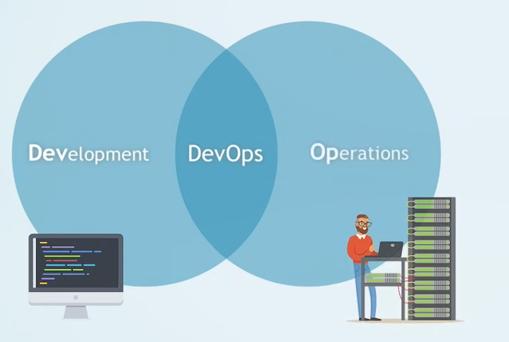
Introduction to DevOps
DevOps is a software development paradigm that combines Development (Dev) and Operations (Ops).
It focuses on continuous collaboration between developers and IT operations teams.
The goal is to deliver software faster, reliably, and with high quality.

Slide 31
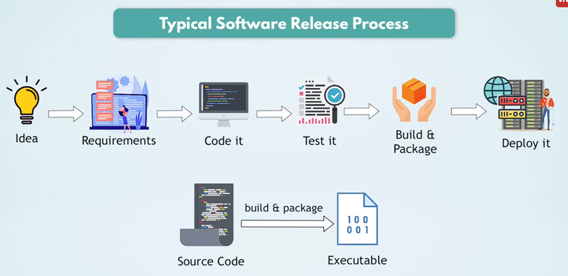
Typical SDLC

Slide 32
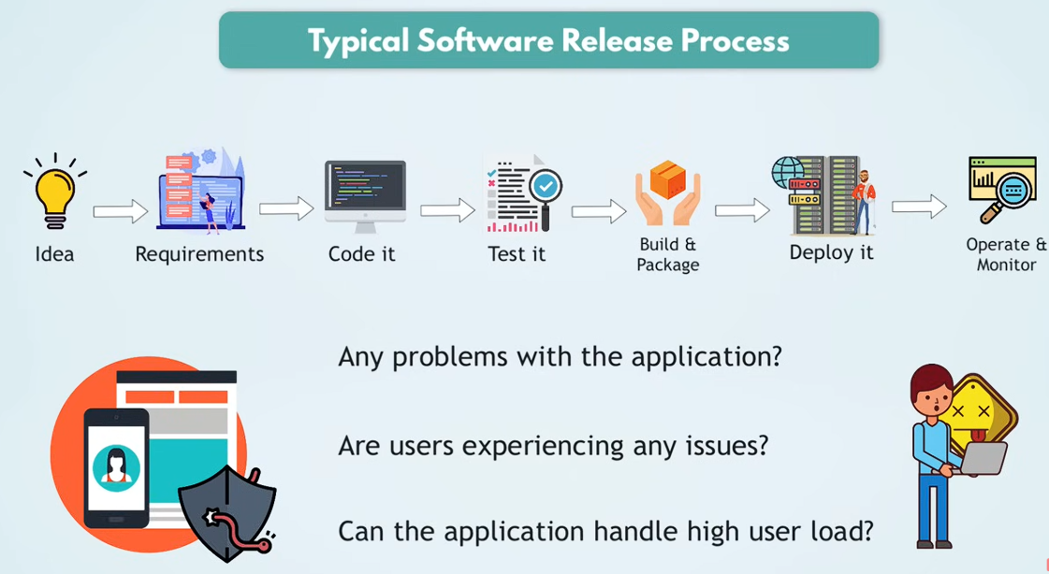

Slide 33
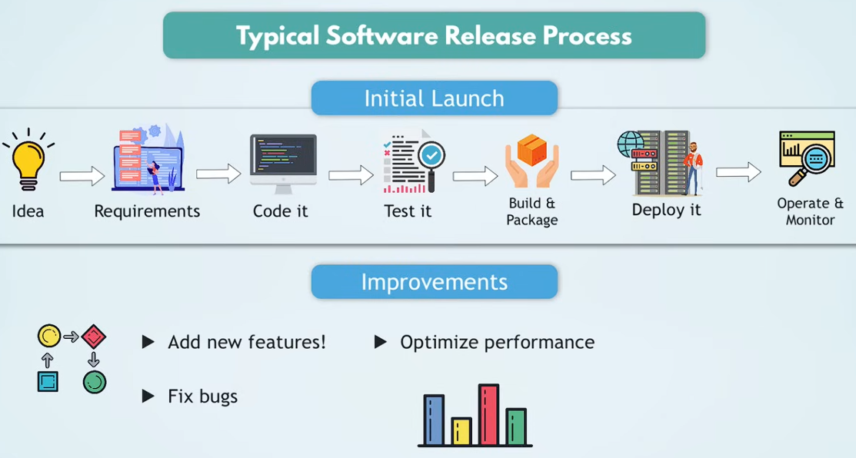
Make improvements accessible to end users immediately!

Slide 34
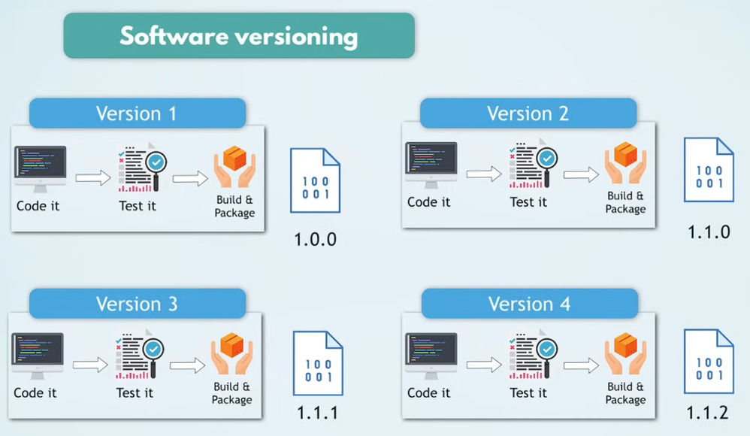

Slide 35
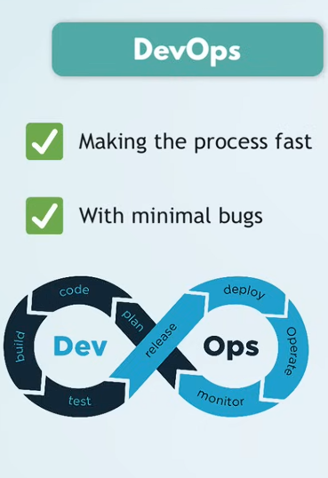
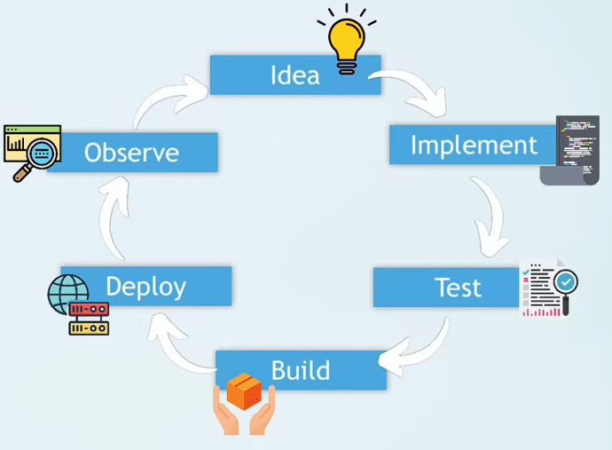
Continuous Development process – Quickly Delivering High Quality Code

Slide 36
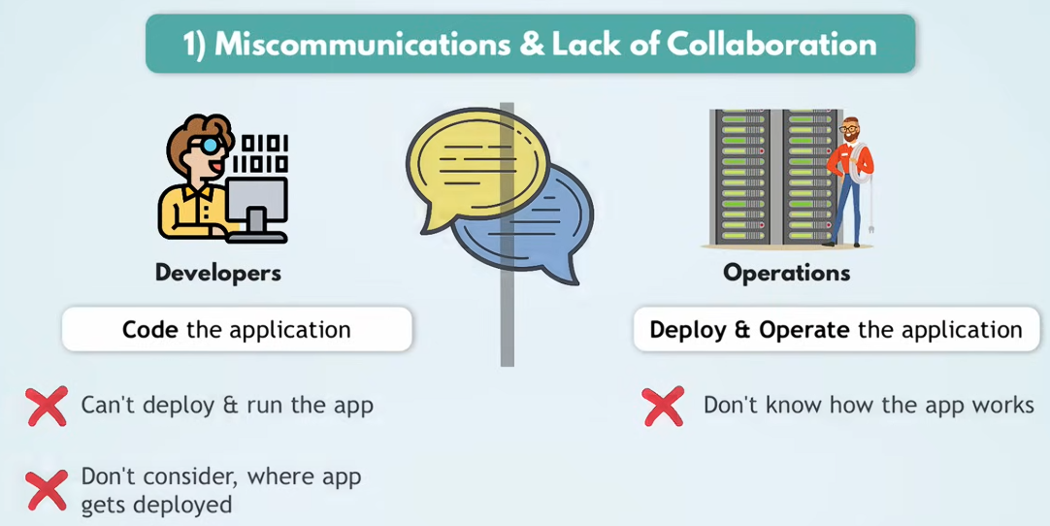
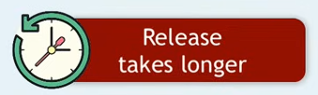
Why Devops?
Miscommunications and lack of collaboration between the development and IT teams:
Netflix developers push a new video recommendation algorithm. It works perfectly on their laptop. But on the production server, it uses 3x more RAM because the server has a different configuration. The app crashes for millions of users.
Why? Developers didn't think about production environment. Operations didn't understand what the code needed.
DevOps Fix: Both teams sit together. Developers document infrastructure needs. Operations are involved from day one.
Deployment guide for operations is not good enough

Slide 37
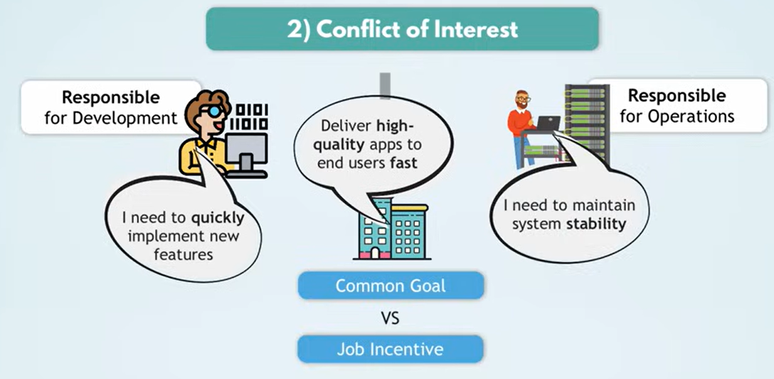
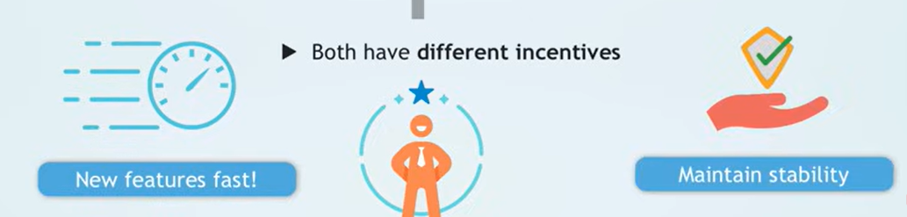
Why Devops?
Conflicting Goals:
Developers are measured by: "How many features did you ship this month?"
Operations are measured by: "How many hours was the app DOWN this month?“
These are opposite incentives.
Amazon deploys code to production every 11.7 seconds (yes, really). This is only possible because Dev and Ops are no longer separate tribes — they share responsibility.

Slide 38
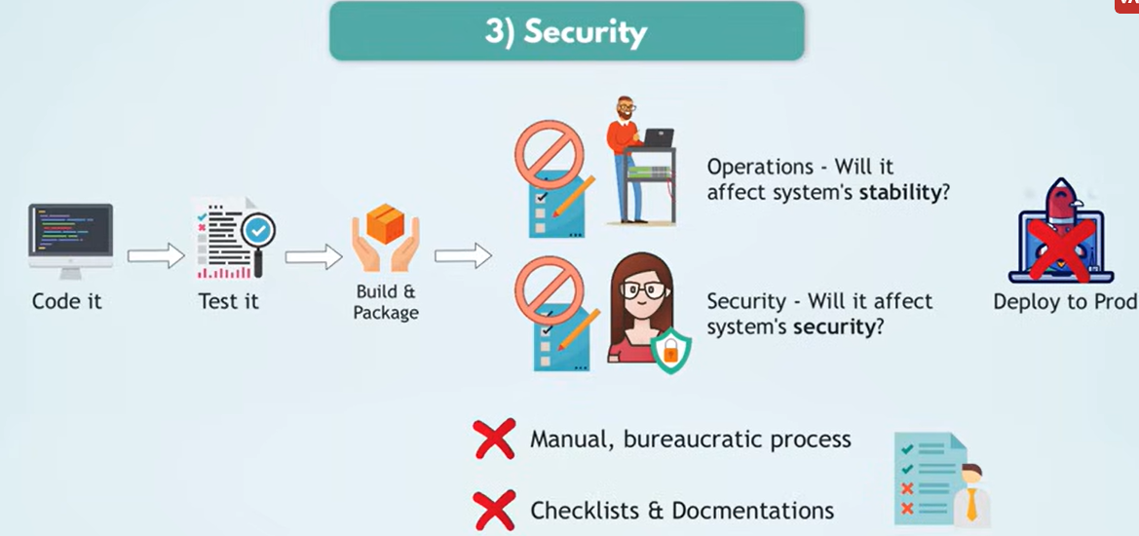
Why Devops?
Security:
A startup builds an app, ships it fast, and only calls the security team after launch. Security team finds 12 vulnerabilities. Now they have to patch a live system used by customers — very risky.
DevSecOps Fix: Security checks are baked into the pipeline. Every time code is pushed, an automated security scanner runs. No human bottleneck.
.

Slide 39
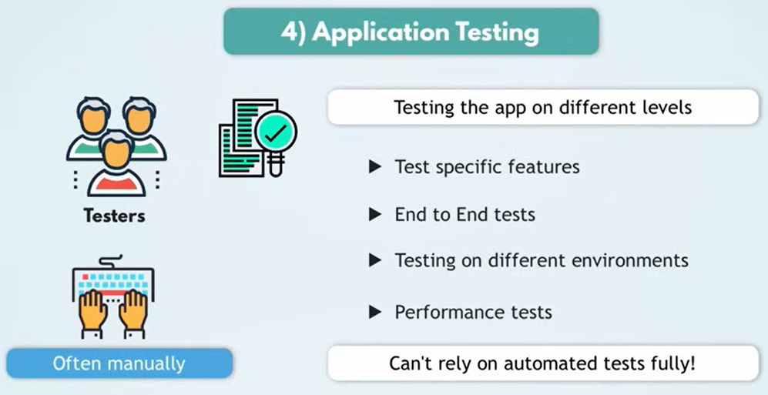
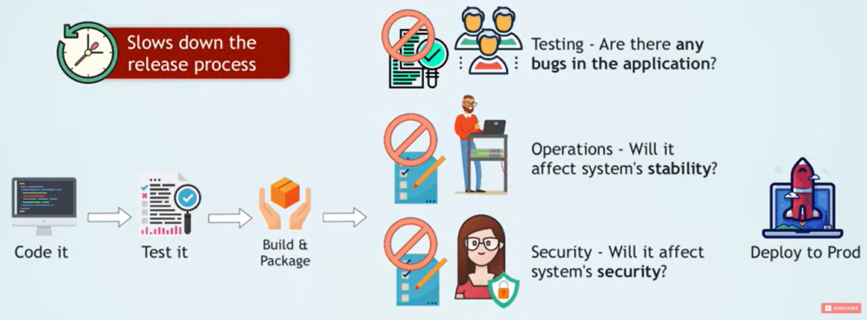
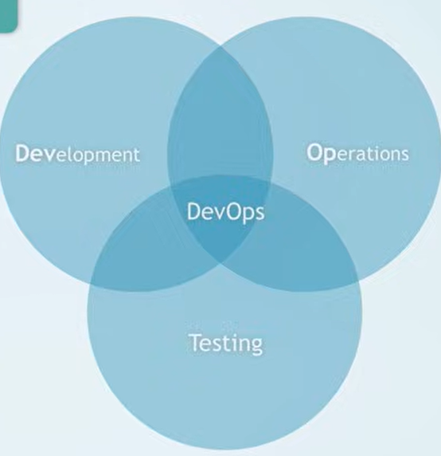
Why Devops?
No Automated Testing:
Facebook once pushed a bug that logged out every user on Earth simultaneously. Why? A routine config change wasn't tested properly.
DevOps Fix: Automated tests run on every single code change, before it ever reaches production.
.

Slide 40
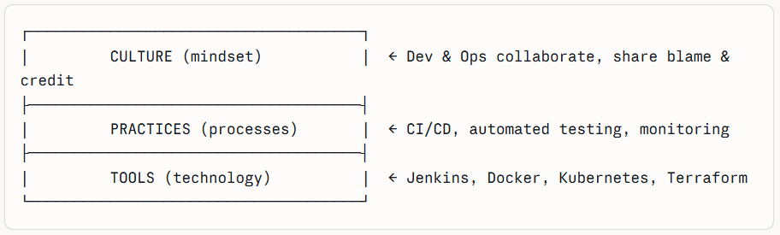
DevOps is the practice of continuously delivering high-quality software faster by unifying development and operations through shared culture, automation, continuous testing, and constant monitoring.

Slide 41
Key Principles of DevOps
1. Collaboration & Shared Responsibility Developers and operations work as a single unified team, sharing ownership of the entire software lifecycle — from writing code to keeping it running in production. There are no silos, no blame games. When something breaks at 2 AM, it's everyone's problem, not just Ops.
2. Automation Every repetitive manual task — building, testing, deploying, infrastructure setup, security checks — is automated. This eliminates human error, speeds up delivery, and frees engineers to focus on meaningful work rather than clicking buttons.
3. Continuous Integration & Continuous Deployment (CI/CD) Code changes are frequently merged, automatically tested, and rapidly released to users. Instead of one big risky release every few months, small safe changes go out constantly — making each deployment less scary and easier to roll back if needed.
4. Continuous Testing Quality is not an afterthought. Every code change automatically triggers a suite of tests before it progresses through the pipeline. Bugs are caught immediately at the source — not weeks later in production where they cost far more to fix.
5. Continuous Monitoring Once deployed, applications and infrastructure are watched 24/7 through real-time dashboards and alerts. Issues like performance degradation, crashes, or unusual traffic spikes are detected and acted on instantly — often before users even notice something is wrong.

Slide 42

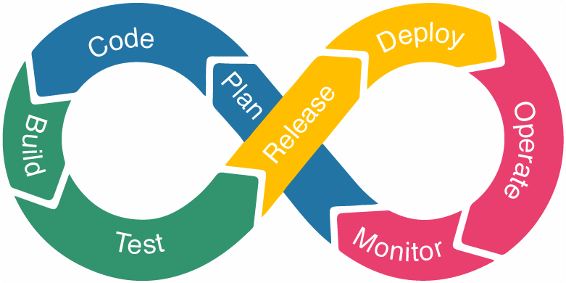
DevOps Lifecycle
Plan: Define features and requirements.
Develop: Write and review code.
Build & Test: Automatically build and test code.
Deploy: Release software to production automatically.
Operate: Maintain and manage infrastructure.
Monitor: Track performance and user feedback.

Slide 43
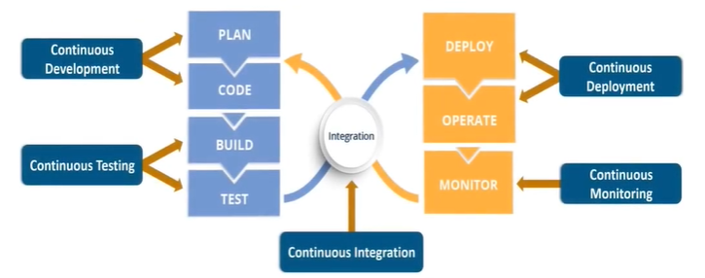
DevOps Lifecycle (Contd.)
DevOps Lifecycle

Slide 44
Continuous Development

Slide 45
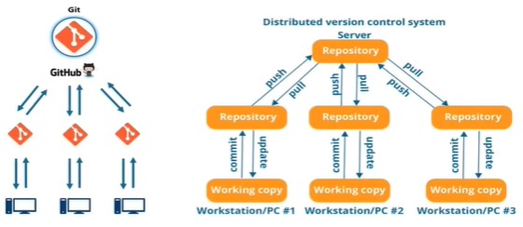
DevOps Lifecycle (Contd.)
Stage 1: Continuous Development

Slide 46
DevOps Lifecycle (Contd.)
Stage 1: Continuous Development -
Continuous Development is the foundation of the entire DevOps lifecycle. Rather than planning everything upfront and coding in one giant batch, teams work in small, continuous cycles — constantly planning, coding, and improving. The goal is to keep development always moving forward, never stalled.
Planning, Before a Single Line of Code is Written :
Every development cycle starts with planning. Teams decide:
What features to build next?
What bugs to fix?
What improvements to prioritize?
Tools like Jira, Trello, or Azure Boards are used to break work into small manageable tasks. Instead of planning a 6-month release, teams plan 2-week sprints — small focused bursts of work with clear goals.
A food delivery app team plans Sprint 14: "Add live order tracking, fix payment timeout bug, improve search speed." Three tasks, two weeks, clear ownership.

Slide 47
DevOps Lifecycle Stage 1: Continuous Development (Contd.)
Coding can be written in any language. The actual development can be done in any programming language — Python, Java, JavaScript, Go, Ruby — whatever suits the application best. DevOps doesn't dictate how you write code, only how you manage and deliver it.
All code is maintained using Version Control Systems (VCS). Every line of code written is tracked using a Version Control System (VCS), most commonly Git. This means:
Every change is recorded with who made it, when, and why
Any mistake can be rolled back instantly to a previous working state
Multiple developers can work simultaneously without overwriting each other
Example: A developer accidentally deletes a critical function. Without Git, it's gone forever. With Git, one command restores it in seconds (git revert commit_id)
A central repository acts as a single source of truth for the project.

Slide 48
DevOps Lifecycle Stage 1: Continuous Development (Contd.)
Developer Collaboration: Developers don't work in isolation. Developers collaborate using the latest committed code.
They continuously:
Pull the latest code before starting work — so they're always building on the most current version.
Commit changes frequently in small chunks — reducing the risk of conflicts
Push completed work back to the central repo — so teammates immediately benefit from their changes
Review each other's code through Pull Requests — catching bugs before they spread
Example: Developer 1 finishes the payment module at 11 AM and pushes it. Developer 2, working on the checkout flow, pulls that update at 11:05 AM and immediately builds on top of it. No waiting, no delays.

Slide 49
DevOps Lifecycle Stage 1: Continuous Development (Contd.)
A key DevOps principle is that Operations teams have full visibility into the same codebase as developers. Operations teams can access the same code while planning releases.
This means:
Ops can understand what is being built before release day surprises them
Ops can plan infrastructure needs based on upcoming features
Ops can flag deployment concerns during development — not after
Example: Operations notices developers are building a video upload feature. They proactively scale up storage capacity on AWS before the feature ships — avoiding a launch-day crisis.

Slide 50
DevOps Lifecycle (Contd.)
Stage 1: Continuous Development ( Recap)
Version control enables:
Tracking code changes
Collaboration among team members
Rollback to previous stable versions in case of bugs or failures
Commonly used tools:
Git
SVN
Mercurial
CVS
JIRA (for issue tracking and coordination)

Slide 51
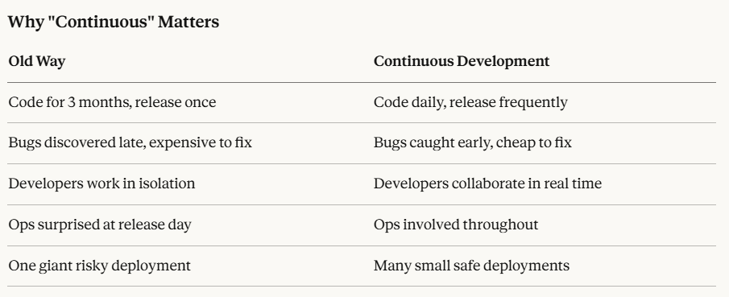

Slide 52
Continuous Integration

Slide 53
DevOps Lifecycle (Contd.)
Stage 2: Continuous Integration: Continuous Integration is the practice of frequently merging every developer's code into a shared central repository — and automatically testing and building it each time. The goal is simple: catch problems immediately when they're introduced, not weeks later when they've grown into something much harder to fix.
Before CI, teams would develop in isolation for weeks or months, then try to merge everything together at the end. This was so painful it earned a name — Integration Hell.
Example: Five developers each spend 3 weeks building separate features of a banking app. On merge day they try to combine everything. The code conflicts are everywhere, features break each other, the database schema is incompatible, and nobody remembers exactly what they changed 3 weeks ago. Fixing this takes another 2 weeks.
With CI, each developer merges their code daily. Conflicts are tiny, caught immediately, and fixed in minutes.

Slide 54
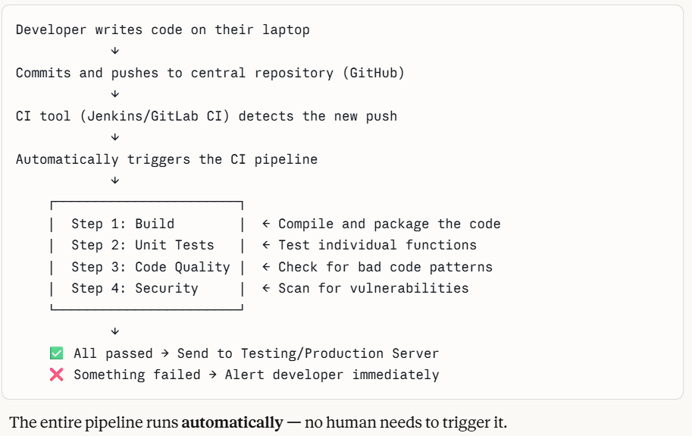
How CI Works — Step by Step

Slide 55
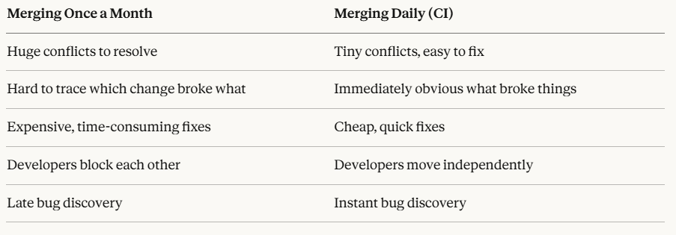
Benefits of Frequent Integration
Example: Amazon integrates and deploys code thousands of times per day. Each change is tiny and automatically tested. If something breaks, they know within minutes exactly which change caused it and who made it.

Slide 56
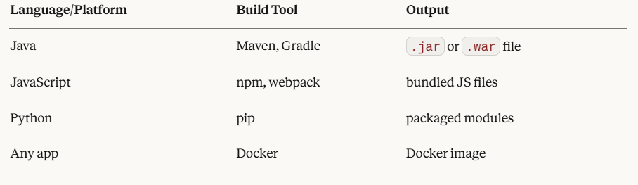
Automated Build & Packaging
When code is pushed, the CI tool automatically builds and packages the application into a deployable format. Depending on the technology stack this looks different:
Example: A developer pushes a bug fix to the checkout service. Jenkins automatically pulls the code, runs mvn package, produces a fresh .jar file, wraps it in a Docker image, and pushes it to DockerHub — all within 3 minutes, without any human involvement.

Slide 57
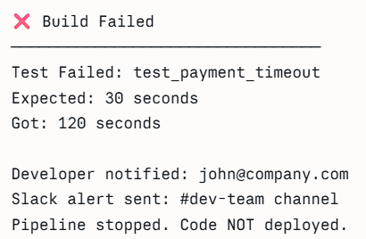
Automated Testing
Code is not allowed to move forward unless it passes all automated tests. Think of it as a quality checkpoint that never sleeps.
Three levels of testing typically run in CI:
Unit Tests — Test individual functions in isolation.
Example- Does the calculate_delivery_fee() function return the correct value for different inputs?
2. Integration Tests — Test how different parts work together
Example- Does the payment service communicate correctly with the order service?
3. Code Quality Checks — Catch bad code patterns
Example- Are there unused variables? Is the code too complex? Does it follow team coding standards?
Example: Netflix runs thousands of automated tests on every code push. A change that breaks even one test is immediately rejected and the developer is notified. Nothing broken ever reaches the user.

Slide 58
DevOps Lifecycle (Contd.)
Stage 2: Continuous Integration (Recap.):
Continuous Integration transforms code merging from a dreaded, painful event into a routine, automated, stress-free process. Every push is an opportunity to verify that the codebase is healthy. Every failure is caught early and cheaply. By the time code reaches users, it has already passed through multiple automated quality gates — making releases faster, safer, and far more reliable..
New features are integrated with existing code early and often. Frequent integration helps detect conflicts and defects early. Continuous Integration reduces integration problems and build costs.
Code is automatically built, packaged, and tested after integration.
Integrated code is sent to testing or production servers.
CI relies on automated test execution to reduce manual effort.
Commonly used CI tools include:
Jenkins
GitLab CI

Slide 59
Continuous Testing

Slide 60
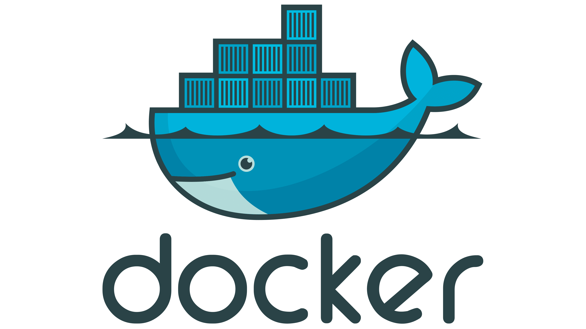
DevOps Lifecycle (Contd.)
Stage 3: Continuous Testing
Continuous Testing is the practice of automatically running tests at every stage of the delivery pipeline — catching bugs, performance issues, and security vulnerabilities as early as possible, before they ever reach real users.
Testing in Isolated Environments Using Docker: Tests don't run on the actual production server; they run in dedicated test environments that closely mirror production. Today, these environments are almost always built using Docker containers.

Slide 61
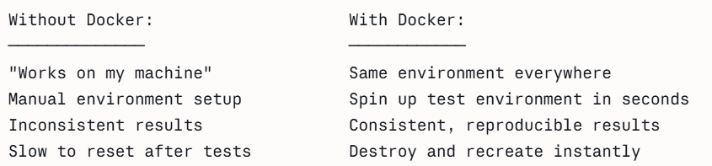
Why Docker for testing?
Docker is a containerization platform that packages your application together with everything it needs to run — so it runs identically everywhere. That "everything it needs" includes:
The programming language runtime (Python, Java, Node.js)
All libraries and dependencies
Configuration files
Environment variables
System tools
This complete package is called a Container.
Example: Your food delivery app needs to test against a real database. Instead of using the live production database (dangerous), Docker spins up a fresh, isolated database container just for testing. Tests run, results are captured, container is destroyed. Production is never touched.
Each test environment is:
Identical to production
Isolated from other environments
Disposable — created and destroyed automatically per test run

Slide 62
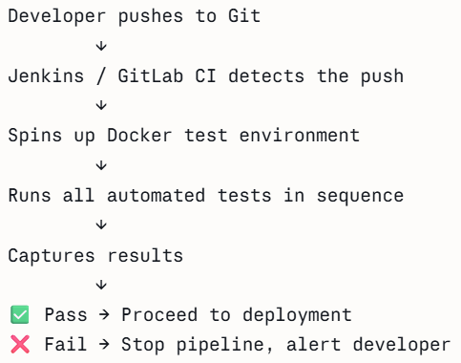
DevOps Lifecycle (Contd.)
Stage 3: Continuous Testing
Automation testing replaces repetitive manual testing and improves accuracy. Before Continuous Testing, a QA engineer would manually click through the application checking every feature after every change. This was:
Slow — taking days or weeks
Inconsistent — humans miss things when tired
Unscalable — 10 developers pushing code daily cannot be manually tested
CI Tools Trigger Tests Automatically: Continuous Testing doesn't work in isolation, it is triggered and orchestrated by CI tools like Jenkins or GitLab CI. The CI tool watches the repository and fires the test pipeline the moment new code arrives. This entire process is fully hands-free, running identically every single time, day or night.

Slide 63
DevOps Lifecycle (Contd.)
Stage 3: Continuous Testing
Types of Automated Tests:
Unit Tests — Test individual functions in isolation
Integration Tests — Test how services work together
Performance Tests — Test behavior under heavy load
Regression Tests — Ensure old features still work after new changes
Security Tests — Scan for vulnerabilities automatically

Slide 64
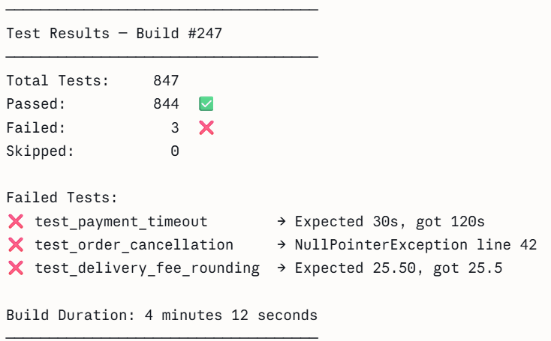
DevOps Lifecycle (Contd.)
Stage 3: Continuous Testing
Automatic Test Reports:
After every test run, the CI tool automatically generates a detailed test report showing:
How many tests ran
How many passed and failed
Exactly which test failed and why
How long each test took
Trends over time — is the codebase getting healthier or worse?

Slide 65
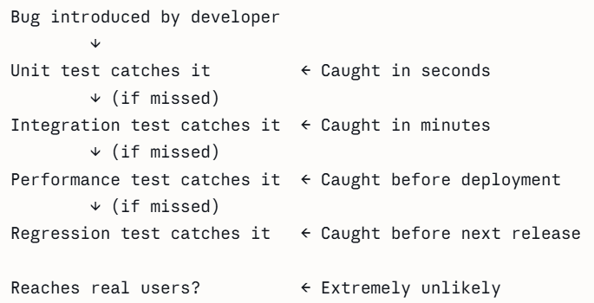
DevOps Lifecycle (Contd.)
Stage 3: Continuous Testing
Continuous Testing Reduces Bugs & Improves Reliability: The core reason bugs reach production is that they go undetected for too long. Continuous Testing eliminates this by creating multiple automatic checkpoints.
Continuous Testing is the quality backbone of the DevOps pipeline. By automatically testing every code change in isolated environments, generating instant reports, and blocking broken code from progressing, it ensures that only well-verified, reliable software reaches deployment. The result is fewer bugs in production, faster releases, and a team that can ship confidently knowing every change has been thoroughly and automatically validated.

Slide 66
Continuous Deployment

Slide 67
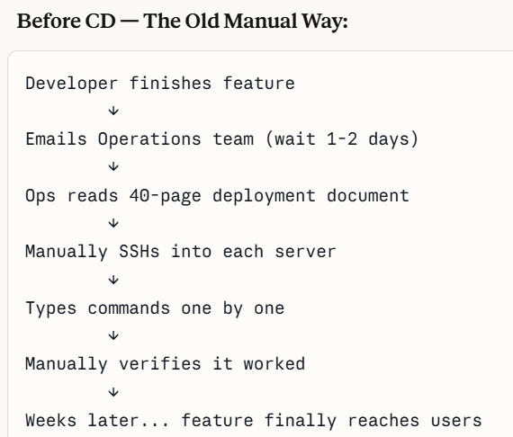
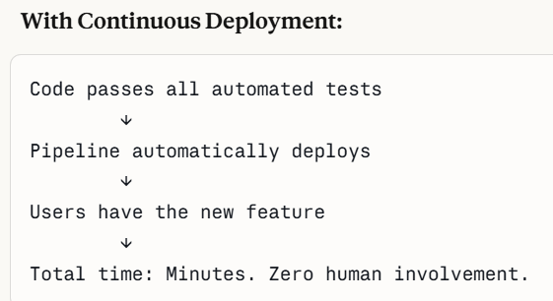
DevOps Lifecycle (Contd.)
Stage 4: Continuous Deployment
Continuous Deployment is the stage where code that has passed all tests is automatically delivered to servers and made live for real users — with zero manual intervention. It is the final and most critical bridge between your development pipeline and the end user.
The Problem CD Solves — Manual Deployment Pain
Notes:
Docker is a tool that helps you package an application along with everything it needs to run (code, libraries, dependencies, settings) into a single unit called a container.
In simple words
Docker makes sure an application runs the same way on every system.

Slide 68
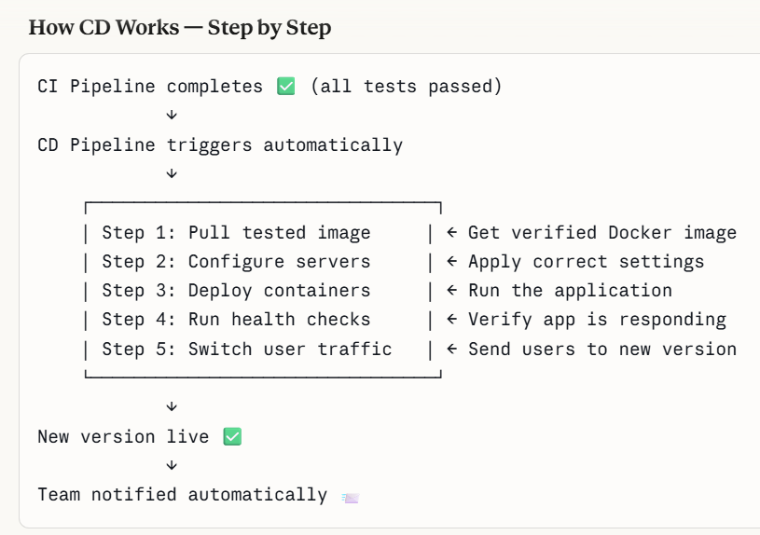

Slide 69
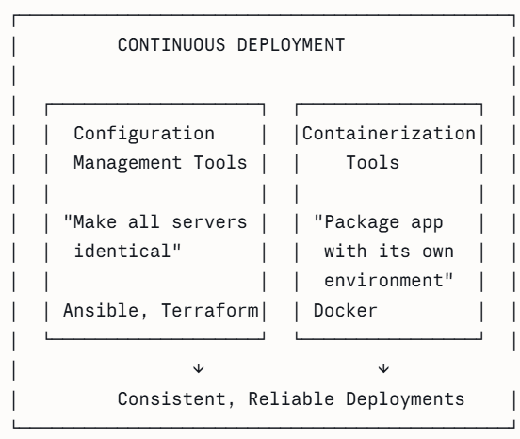
DevOps Lifecycle (Contd.)
Stage 4: Continuous Deployment
Deployment is handled using mainly two tools working together:
Configuration Management tools
Containerization tools
Notes:
Docker is a tool that helps you package an application along with everything it needs to run (code, libraries, dependencies, settings) into a single unit called a container.
In simple words
Docker makes sure an application runs the same way on every system.

Slide 70
DevOps Lifecycle (Contd.)
Stage 4: Continuous Deployment
What is Configuration Management?
Before your application runs on a server, that server needs to be properly set up. It needs:
Correct software installed (Docker, Java, Nginx)
Correct firewall rules configured
Correct ports opened
Correct environment variables set
Correct user permissions applied
Doing this manually on one server is painful. On 100 servers it is completely impractical.
Configuration Management tools automate this by letting you describe the desired state of a server in code and automatically applying it across every server simultaneously.
This concept is called Infrastructure as Code (IaC), your server configuration is written, versioned, and managed just like application code.
Example: Your food delivery app suddenly needs a security patch applied to 80 servers. Without Config Management: two engineers spend two days SSHing into each server manually. One typo on server 47 causes a crash at 2 AM. With Ansible: one engineer changes one line of code, runs the playbook, all 80 servers patched in 10 minutes — identically.
Notes:
Docker is a tool that helps you package an application along with everything it needs to run (code, libraries, dependencies, settings) into a single unit called a container.
In simple words
Docker makes sure an application runs the same way on every system.

Slide 71
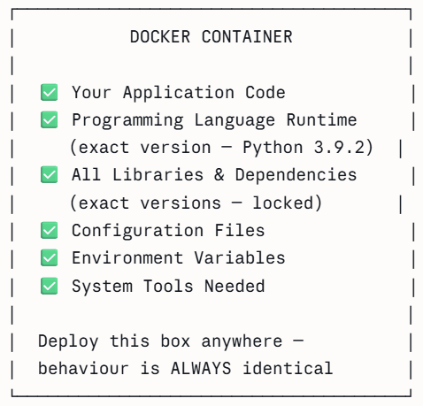
DevOps Lifecycle (Contd.)
Stage 4: Continuous Deployment
2. Containerization tools: Containerization means packaging your application together with everything it needs to run, into one self-contained unit called a container. This container behaves identically no matter where it runs ,your laptop, a test server, or a live production server.
A container is not just your code. It is your code plus its entire world →
Docker is by far the most widely used containerization tool in DevOps today. It is the industry standard that almost every company uses.
Notes:
Docker is a tool that helps you package an application along with everything it needs to run (code, libraries, dependencies, settings) into a single unit called a container.
In simple words
Docker makes sure an application runs the same way on every system.

Slide 72
DevOps Lifecycle (Contd.)
Stage 4: Continuous Deployment(Recap)
Ensures consistent environments across development, testing, and production.
Helps achieve consistent and high-quality releases.
Reduces manual deployment effort and minimizes human errors.
Containerization packages applications with all dependencies, ensuring uniform behavior across environments.
Docker is the most widely used containerization tool.
Notes:
Docker is a tool that helps you package an application along with everything it needs to run (code, libraries, dependencies, settings) into a single unit called a container.
In simple words
Docker makes sure an application runs the same way on every system.

Slide 73
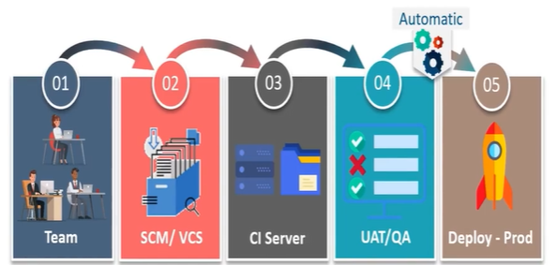
DevOps Lifecycle (Contd.)
Stage 4: Continuous Deployment (Contd.)
Configuration Management Tools
Puppet
Chef
Ansible
SaltStack
Cloud Platforms Supporting Containers
AWS ECS
Azure Container Service
Google Container Engine

Slide 74
Continuous Monitoring

Slide 75


Slide 76
DevOps Lifecycle (Contd.)
Stage 5: Continuous Monitoring
Once code is deployed and live, the job isn't done. Continuous Monitoring means the system is watched 24/7, automatically, so problems are caught before users even notice them. It is the safety net of the entire DevOps lifecycle.
Infrastructure metrics track the health of the servers and cloud resources running the app- CPU usage, RAM consumption, disk I/O, and network throughput. If a server is running out of memory, this catches it.

Slide 77
DevOps Lifecycle (Contd.)
Stage 5: Continuous Monitoring
Application metrics track how the software itself is performing, response times (latency), request throughput, error rates, and queue depths. These reveal whether the code is behaving correctly under real load.
Logs are detailed event records generated by the application — every request handled, every exception thrown, every database call made. Tools like the ELK Stack (Elasticsearch, Logstash, Kibana) or Splunk aggregate and search these. They're essential for diagnosing exactly what went wrong.

Slide 78
DevOps Lifecycle (Contd.)
Stage 5: Continuous Monitoring
UX signals come from the end-user side- real user monitoring (RUM) tools measure actual page load times, JavaScript errors in the browser, and mobile app crash rates. This catches issues that only appear on certain devices or network conditions.
The ops team (also called SRE - Site Reliability Engineers) owns this stage. Their responsibilities include:
Maintaining the monitoring infrastructure and keeping dashboards up to date
Writing and tuning alert rules so the team gets notified without alert fatigue.
Being on-call to respond to incidents, often following runbooks (step-by-step response guides)
Performing root cause analysis (RCA) after incidents and writing post-mortems
Feeding findings back into Stage 5 (Continuous Feedback) so developers can fix underlying issues

Slide 79
DevOps Lifecycle (Contd.)
Stage 5: Continuous Monitoring (Contd.)
Common monitoring tools:
Splunk
ELK Stack (Elasticsearch, Logstash, Kibana)
Nagios
New Relic
ELK Stack helps in:
Log collection
Search and analysis
Visualization and management

Slide 80
Continuous Feedback

Slide 81

DevOps Lifecycle (Contd.)
Stage 6: Continuous Feedback
Continuous Feedback is the stage where the DevOps loop "listens." After software is deployed and running in production, the system gathers signals from real users and the live environment to inform what comes next. Without this stage, teams are guessing about what to improve — with it, every release is smarter than the last.

Slide 82
Continuous Operations

Slide 83

DevOps Lifecycle (Contd.)
Stage 7: Continuous Operations
Continuous Operations is the stage where everything that used to require manual human effort — provisioning servers, running tests, deploying code, restarting services — is fully automated. The goal is that a developer can push code and the system takes it all the way to production on its own, reliably and repeatedly, without anyone having to "do the deploy."

Slide 84
DevOps Lifecycle (Contd.)
Stage 7: Continuous Operations
Automated testing runs first — unit tests, integration tests, and smoke tests validate the code before it ever touches production. If anything fails, the pipeline stops and the developer is notified immediately.
Infrastructure as Code (IaC) tools like Terraform and Ansible automatically provision and configure the servers, databases, and network rules an application needs, while configuration management ensures the correct environment variables and secrets are injected into each environment — eliminating manual setup and making every deployment fast, consistent, and reproducible.

Slide 85

DevOps Lifecycle (Contd.)
Stage 7: Continuous Operations
Deployment itself is executed via strategies designed to be safe and automatic:

Slide 86
DevOps Lifecycle (Contd.)
Stage 7: Continuous Operations
Before DevOps, a "release cycle" could take weeks or months, code was batched up, tested manually, and deployed in large risky chunks. Continuous Operations shrinks this dramatically.
Short cycles matter because:
Smaller releases carry less risk, if something breaks, there's less code to investigate
Bugs are fixed and in users' hands faster
Feedback from Stage 5 and Stage 6 reaches developers quickly, so improvements happen in days rather than months
The team never sits on a pile of unreleased work, which creates anxiety and instability
Companies like Amazon and Netflix deploy to production hundreds or even thousands of times per day — this is only possible because of Continuous Operations automation.

Slide 87
DevOps Lifecycle (Contd.)
Stage 7: Continuous Operations
Developers Focus on New Features: Before Continuous Operations, developers spent significant time on operational work, manually running deployments, SSHing into servers, debugging environment mismatches, and babysitting releases. That time is expensive and demoralising.
With Continuous Operations fully in place:
A developer writes code, pushes it, and the system handles everything else
No waiting for an ops team to "do the deploy“- it just happens
No "works on my machine" problems because environments are codified and reproducible
Energy that was spent on repetitive ops tasks flows back into building new features, improving UX, and solving real user problems

Slide 88
Benefits of DevOps
Faster and more efficient software development
Fewer bugs and improved user experience
Better collaboration between Dev and Ops teams
Higher return on investment (ROI)
Automatic deployment supports large-scale systems
Suitable for both small and large teams
Early bug detection through automated testing & monitoring
Streamlined workflows using version control and automation
Continuous feedback improves product quality
Automation reduces effort in testing and deployment

Slide 89
Tools Commonly Used in DevOps
Version Control: Git, GitHub, GitLab
CI/CD Tools: Jenkins, GitHub Actions, GitLab CI
Build Tools: Maven, Gradle
Configuration Management: Ansible, Chef, Puppet
Containerization: Docker
Container Orchestration: Kubernetes
Monitoring & Logging: Prometheus, Grafana, ELK Stack
Cloud Platforms: AWS, Azure, Google Cloud
Testing Tools: Selenium, JUnit, TestNG

Slide 90
Software Architecture

Slide 91
Understanding Software Architecture
Software architecture refers to the high-level structure of a software system, including the components, interactions, and relationships between them.
It provides a blueprint for the software system, which helps in understanding how the different parts of the system fit together and how they will work together to meet the requirements.

Slide 92
Why is Software Architecture Important?
Quality Attributes: It defines the system's properties, such as scalability, reliability, and performance.
Risk Management: It helps identify and mitigate potential risks in the early stages of software development.
Communication: It provides communication between stakeholders, aiding understanding and collaboration.
Future-Proofing: It makes future changes and enhancements more manageable by providing a clear structure and roadmap.

Slide 93

Key Concepts in Software Architecture
Components, Connectors, and Configurations: Components are the main building blocks, connectors define how they communicate, and configuration describes how they are arranged in the system.
Component - A component is a modular, deployable, and replaceable unit of a system that encapsulates a set of related functions or data.
Key Properties of a Good Component
High Cohesion — everything inside it belongs together
Low Coupling — it depends minimally on other components
Encapsulation — it hides its internal implementation
Replaceability — it can be swapped without breaking others

Slide 94
Key Concepts in Software Architecture
Connectors — The Communication Channels
They define how components talk to each other. Connectors carry data, control, and coordination signals between components.
Types of Connectors
Procedure Call Connectors (Synchronous) The caller waits for a response before continuing. Simple and predictable.
Event-Based Connectors (Asynchronous) The sender fires a message and moves on. The receiver processes it independently.
3. Data Stream Connectors - Continuous flow of data between components, processed in real time.

Slide 95

Key Concepts in Software Architecture
Configurations — The Arrangement
A configuration describes how components and connectors are assembled and arranged to form a working system. The same components with different configurations create entirely different systems.

Slide 96


Key Concepts in Software Architecture
Architectural Styles and Patterns: Standard design approaches that provide proven solutions for organizing system structure (e.g., layered, microservices).
Layers and Tiers in Architecture: Layers separate responsibilities logically, while tiers separate system parts physically across different machines or environments.

Slide 97


Slide 98
Architectural Design Decisions
How and when to make design decisions
Made after understanding business goals and system requirements.
Focus first on high-impact components; delay uncertain decisions when possible.
Factors influencing these decisions
Business needs, budget, scalability, security, and performance requirements.
Team expertise, technology choices, time constraints, and compliance needs.
Importance of trade-offs in architecture
Every architectural choice has advantages and disadvantages.
Architects must balance cost, performance, scalability, and maintainability.

Slide 99
Common Architectural Styles
Monolithic Architecture
Microservices Architecture
Serverless Architecture
Event-Driven Architecture

Slide 100

Common Architectural Styles (Contd.)
Monolithic Architecture: The entire application is built as a single unified system where all components are tightly connected. Everything lives in one giant codebase, deployed as one single unit. It is simple to develop initially but can become difficult to scale and maintain as the system grows.
How it Works in Real Life
Imagine building a food delivery app as a monolith:
All code — users, restaurants, orders, payments, delivery tracking — lives in one project
You run one server, deploy one application
A bug in the coupon system? You redeploy the entire app to fix it
Traffic spikes during lunch? You scale up everything, even the parts that aren't busy

Slide 101

Common Architectural Styles (Contd.)
Microservices Architecture: The application is divided into small, independent services that communicate through APIs. It improves scalability and flexibility but increases system complexity and management effort.
How it Works in Real Life :Same food delivery app, now as microservices:
User Service — handles registration, login, profiles
Restaurant Service — manages menus and availability
Order Service — processes and tracks orders
Payment Service — handles transactions
Delivery Service — tracks drivers in real time
Notification Service — sends SMS and emails
Each service has its own codebase, its own database, its own deployment. They talk to each other through APIs — like separate departments in a company sending emails to coordinate.
Why It's Powerful
Independent scaling — lunch rush hits Order Service? Scale just that, nothing else
Independent deployment — fix a bug in Payments without touching Delivery
Fault isolation — Notifications go down? Orders still process fine
Technology freedom — Payment Service in Java, Recommendation Service in Python, no problem
Team independence — each team owns their service end-to-end

Slide 102


Common Architectural Styles (Contd.)
Serverless Architecture: Applications run on cloud-managed services where the provider handles infrastructure and scaling. It reduces operational overhead but may lead to vendor dependency and limited control.
Benefits of Serverless:
No Infrastructure Management
True Pay-Per-Use
Infinite Auto-Scaling

Slide 103


Common Architectural Styles (Contd.)
Event-Driven Architecture: Components communicate by producing and responding to events. This allows high scalability and loose coupling but can make debugging and monitoring more complex.

Slide 104
Importance of Modularity
Definition of Modularity
Modularity is designing software as independent, self-contained modules with specific responsibilities.
Benefits of Modularity in Software Design
Improves maintainability, scalability, reusability, and easier testing.
Strategies to Achieve Modularity: Use
Separation of concerns: Divide the system so each part handles one specific task only.
Clear interfaces: Define simple and clear rules for how different parts communicate with each other.
Loose coupling: Keep modules independent so changes in one module don’t heavily affect others.
High cohesion: Make sure each module focuses on closely related tasks and has a clear purpose.

Slide 105
Software architecture characteristics
Aligning Architecture with Business Goals: The system design should support business objectives and deliver value.
Scalability: Ability of the system to handle growth in users, data, or workload.
Maintainability: Ease of fixing bugs, updating features, and improving the system.
Extensibility: Ability to add new features without major changes to existing code.
Flexibility: Ability to adapt to changing requirements or technologies.
Performance Efficiency: System should respond quickly and use resources effectively.
Security: Protects data and system from unauthorized access and threats.
Usability: System should be easy and user-friendly to operate.
Reusability: Components can be reused in other parts of the system or in different projects.

Slide 106
Software Design

Slide 107
Understanding Software Design
Software design refers to the process of creating a plan, blueprint, or architecture for a software system.
It involves making decisions about the structure, functionality, and behavior of the system, as well as the algorithms and data structures that will be used to implement it.

Slide 108



Understanding Software Design
Software design is a critical step in the software development process, as it helps ensure that the system is developed efficiently, effectively, and meets the requirements of its users.
It involves a series of activities, including:
Defining the system's requirements and constraints
Creating models, prototypes, and diagrams to represent the system's architecture and functionality
Identifying and evaluating design options and trade-offs
Selecting the most appropriate design solution
Documenting the design in sufficient detail to allow for its implementation

Slide 109
Design Principles
Divide the system so each part handles a specific responsibility.
Build the system using independent, self-contained components.
Hide complex details and show only necessary features.
Follow five object-oriented principles that improve design and maintainability.
Avoid duplicating code or logic.
Keep the design simple and avoid unnecessary complexity.
Do not add features until they are actually required.
Write tests before writing the actual code to ensure correctness.

Slide 110
Design Patterns
Design patterns at the software design level are reusable solutions to common problems that arise during the software design process.
They provide a proven, standardized approach to solving specific design problems, making it easier for developers to create robust, maintainable, and extensible software systems.

Slide 111
Desirable Characteristics of a Design
Minimal complexity
A design should be simple and easy to understand, avoiding unnecessary complexity that can make it hard to maintain and extend. Example: If you need to store a list of names, don't use a complex, custom-built binary tree if a simple Array or List does the job.
Ease of maintenance
A design should be easy to maintain and modify, with a focus on making it self-explanatory for maintenance programmers. Example: Using meaningful variable names like dailyTemperatureAverage instead of dta.
Loose coupling
A design should minimize connections between different parts of a program to reduce the impact of changes and improvements. Loose coupling means that if you change the code in Component A, you don't accidentally break Component B.

Slide 112
Desirable Characteristics of a Design (Contd.)
Extensibility
A design should be modular and allow for easy extension and modification without affecting the underlying structure. Example: An E-commerce site. You should be able to add "Crypto Payments" as a new module without having to rewrite the "Shopping Cart" or "Product Catalog" logic.
Reusability
A design should promote reusability by utilizing modular, flexible, and standardized components. Example: A Login/Authentication module. Instead of writing a login system for every app, a company builds one high-quality, secure "Login Service" that all their apps use.
High fan-in
A design should have a high number of classes that use a given class, indicating good use of utility classes Example: A MathLibrary class that has methods for calculateTax() or convertCurrency(). If every other class in the system uses it, it has High Fan-in..

Slide 113
Desirable Characteristics of a Design (Contd.)
Low-to-medium fan-out
A design should have a low-to-medium number of classes used by a given class, avoiding high fan-out that may indicate complexity.
Example: If your GenerateInvoice class needs to talk to the Database, Printer, EmailServer, TaxOffice, and InventoryManager directly, its fan-out is too high. You should simplify it.
Portability
A design should be easy to move to another environment, minimizing environment-specific dependencies. Example: Writing an app in Java or using Docker containers.
Leanness
A design should avoid unnecessary parts and code, minimizing the effort required for development, review, testing, and maintenance. Example: If the customer only needs a report in PDF, don't spend three days writing code to export it to Excel, CSV, and HTML "just in case."
Notes:
high fan-out : one part of the system is connected to too many other parts, which can increase complexity and make the system harder to maintain or modify.

Slide 114
Desirable Characteristics of a Design (Contd.)
Stratification
A design should have clear levels of decomposition, allowing for a consistent view at each level without dipping into other levels. The high-level UI shouldn't be talking directly to the low-level hardware bits.
Standard techniques
A design should utilize established, widely-used techniques and tools to create a familiar and easy-to-understand design.Don't reinvent the wheel. Use established Design Patterns (like Singleton or Factory) and standard tools that the global community of software engineers already knows. Example: Using JSON for data transfer instead of creating your own custom text format.

Slide 115

Difference between Architecture and Design
Software design typically involves making decisions about the algorithms, data structures, and other low-level details of the system, while software architecture focuses on the overall shape of the system and how it will meet the requirements.
Software Architecture: Architecture is concerned with the high-level structure and the "Non-functional Requirements" (like security, scalability, and performance). These are the hardest decisions to change later. If you choose a "Microservices" architecture and realize a year later it should have been a "Monolith," it is extremely expensive to fix.
Software Design: Design is concerned with the low-level details and the "Functional Requirements" (how a specific feature actually works). Choosing specific algorithms, data structures (like using a Linked List vs. an Array), and defining how classes interact. These are easier to change or refactor without breaking the whole system.

Slide 116
Microservices and Serverless Architectures

Slide 117

Microservices Architecture (MSA)
Definition: Microservices Architecture is an architectural style in which an application is developed as a collection of small, autonomous services, each running in its own process and communicating through lightweight mechanisms such as REST (Representational State Transfer) or gRPC (Google Remote Procedure Call).
Microservices Architecture
Notes:
gRPC (Google Remote Procedure Call) is a high-performance, open-source framework for building fast, language-agnostic APIs and microservices.

Slide 118
Microservices Architecture (MSA)
Key Characteristics:
Autonomous Services Each service is independently deployable, allowing faster releases and minimal impact on other services.
Loose Coupling Services are loosely coupled, enabling independent development, testing, and maintenance.
Business Capability–Driven Services are organized around specific business functions, often aligned with Domain-Driven Design (DDD) and bounded contexts.
Notes:
gRPC (Google Remote Procedure Call) is a high-performance, open-source framework for building fast, language-agnostic APIs and microservices.

Slide 119
Microservices Architecture (MSA)
Key Characteristics: (Contd.)
Decentralized Data Management Each service follows the database-per-service pattern, ensuring data ownership and independence.
Resilience and Fault Isolation Failures in one service do not propagate to others, supported by patterns such as the Bulkhead pattern.
Small, Cross-Functional Teams Each service is typically owned by a small, dedicated team, improving accountability and agility.
Ease of Maintenance and Testing Smaller codebases make services easier to maintain, test, and evolve.
Notes:
gRPC (Google Remote Procedure Call) is a high-performance, open-source framework for building fast, language-agnostic APIs and microservices.

Slide 120
Microservice vs API – What’s the Difference?
An API is NOT a Microservice
What is an API?
An API (Application Programming Interface) exposes data and behavior to consumers.
Acts as a contract between a system and its clients.
It is an Interface. It tells you how to talk to a system but doesn't care how the system is built.
An API does not define architecture.
What is a Microservice?
A microservice is an architectural style.
Represents a fine-grained, independently deployable service.
Built around a specific business capability.
Owns its logic, data, and lifecycle.

Slide 121

Relationship Between API and Microservices
Microservices may expose APIs, but:
There is no one-to-one relationship.
Multiple microservices can together form a single API.
One API endpoint may aggregate responses from multiple microservices.

Slide 122
When to Use Microservices?
Use Microservices When:
Monolith becomes too complex to manage The application grows so large that it becomes hard to modify and deploy.
Large teams are involved Multiple teams need to work independently on different business functions.
Independent evolution of business functions is required Different modules must change and scale without affecting the whole system.
Scalability requirements increase Different parts of the system need independent scaling.
Multiple user interaction models or tenants exist The system must support diverse clients or multi-tenant environments.

Slide 123
Serverless Architecture

Slide 124


Serverless Architecture
A cloud computing model where the cloud provider manages server provisioning, scaling, and maintenance.
Developers focus entirely on writing and deploying code.
Code runs in fully managed, stateless environments and is triggered by events.
Cloud providers dynamically handle infrastructure, scaling, and resource allocation.
Developers are abstracted from server management tasks like capacity planning and maintenance.

Slide 125


Slide 126

Serverless Architecture

Slide 127
Serverless Computing Providers and Platforms
AWS Lambda
Executes code without provisioning or managing servers
Triggered by events from 200+ AWS services and SaaS apps
Azure Functions
Event-triggered serverless compute
Integrates with Azure services
Supports multiple programming languages
Google Cloud Functions
Serverless execution environment
Google manages scaling and infrastructure
Oracle Cloud Functions
Functions triggered by HTTP or Oracle Cloud events
Integrates with Oracle Cloud services

Slide 128


Steps for Developing Serverless Applications
Step 1: Understand the Serverless Model
Suitable for unpredictable traffic
Well-suited for microservices-based applications

Slide 129





Steps for Developing Serverless Applications
Step 2: Choose the Right Provider
Evaluate supported languages, integrations, provider features
Compare cost, performance, cold start behaviour
Providers: AWS Lambda, Azure Functions, Google Cloud Functions, Oracle Cloud Functions

Slide 130



Steps for Developing Serverless Applications
Step 3: Designing Your Application
Event-driven design, Stateless functions (use databases/cloud storage for state)
Microservices-oriented design

Slide 131

Steps for Developing Serverless Applications (Contd.)
Step 4: Development Environment Setup
Use tools like:
Serverless Framework
AWS SAM (Serverless Application Model)/ Azure Functions Core Tools
Configure local testing and simulation tools

Slide 132
Steps for Developing Serverless Applications (Contd.)
Step 4: Development Environment Setup
Use tools like:
Serverless Framework
AWS SAM
Azure Functions Core Tools
Configure local testing and simulation tools
Step 5: Implementing Functions
Write small, single-purpose functions
Integrate managed services for DB, authentication, storage
Step 6: Managing Dependencies
Include only necessary libraries
Smaller packages improve cold start performance
Step 7: Deployment and Continuous Integration
Automate using CI/CD pipelines
Tools: GitHub Actions, Jenkins, CircleCI

Slide 133


Steps for Developing Serverless Applications (Contd.)
Step 5: Implementing Functions
Write small, single-purpose functions
Integrate managed services for DB, authentication, storage
Step 6: Managing Dependencies
Include only necessary libraries
Smaller packages improve cold start performance
Step 7: Deployment and Continuous Integration
Automate using CI/CD pipelines
Tools: GitHub Actions, Jenkins, CircleCI

Slide 134
Serverless Application Design Patterns
Function-as-a-Gateway (FaG)
Routes incoming HTTP requests
Used for lightweight API gateways
Event Stream Processing
Processes streams of logs, transactions, IoT data
Used for real-time analytics and monitoring
Aggregator
Combines responses from multiple services/functions
Returns a unified response
Strangler Fig Pattern
Gradual migration from legacy systems
New features built using serverless
Circuit Breaker
Prevents cascading failures
Stops repeated failed function calls

Slide 135
Scaling and Performance Considerations
Scaling in Serverless
Automatic Scaling Cloud platform automatically increases or decreases resources based on number of requests/events. No manual scaling required.
Cold Start Latency When a function runs after being idle, it may take extra time to start. This causes a small delay in the first request.
Throttling Cloud providers limit how many function executions can run at a time. If requests exceed the limit, some requests may be delayed.

Slide 136
Performance Optimization Strategies
Optimize Function Code Keep functions small and efficient to reduce execution time.
Manage Dependencies Avoid unnecessary libraries. Smaller code loads faster and reduces startup time.
Persistent Connections Reuse database or service connections to reduce repeated connection delays.

Slide 137
Security Best Practices in Serverless architecture.
Least Privilege Principle (PoLP) Give each function only the permissions it really needs.
Secure Application Secrets Do not hard-code API keys or passwords. Use cloud secret managers.
Input Validation Validate inputs to prevent attacks like SQL injection and XSS.
Secure API Gateway Use authentication, rate limiting, and access control for APIs.
Encryption Encrypt data while sending (HTTPS) and while storing.

Slide 138
Serverless Architecture – Use Cases
Chatbots and Virtual Assistants
Real-time Data Processing and Analytics
Web and Mobile Backends
Scheduled Tasks / Cron Jobs

Slide 139
Challenges of Serverless Architecture
Cold Start Delay First request may be slow after inactivity.
Limited Execution Environment Limits on memory, execution time, and language support.
Debugging and Monitoring Difficulty Harder to trace errors across many small functions.
State Management Complexity Functions are stateless; state must be stored externally.
Security and Compliance Challenges More effort needed to manage security and regulatory requirements.

Slide 140
END OF UNIT-3

